Slide 1
DIFC COURTS
Advantage Dubai
Montreal
16th May, 2017

Slide 2
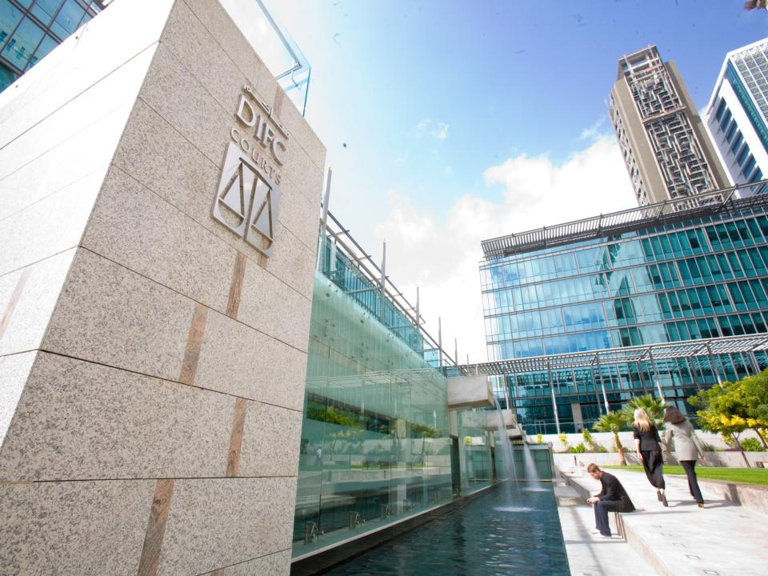
Notes:
Before talking about the Courts, can we talk about Dubai and specifically the Dubai International Financial Centre. Maybe insert movie clip about development of Dubai and time lapse about building of the centre.

Slide 3
DIFC
Notes:
Why did Dubai decide to concentrate on Finance alongside Trade/logistic and travel and tourism as its strategy.
Why create an English language business centre in the Arab world (because 80% of the worlds financial transactions (including Islamic finance transactions) are done in English.
Why use a common law system vs the civil law system (because most of the world’s leading fianncial centres are common law-New York, London, Hong Kong, Singapore etc)
Why in the DIFC? (infrastructure, high end, quality of service etc)

Slide 4
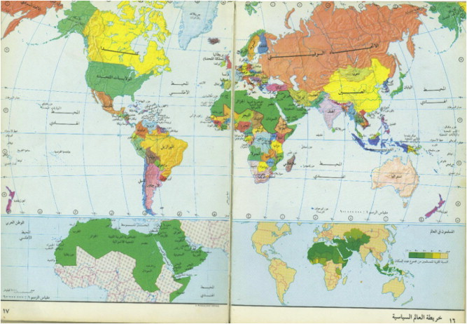
World Trade
Notes:
Answer is the shift in world trade.
Historically world trade centered between the East Coast of the United States and the UK, but with the emergence of Germany after the second world war trade flows started to shift East. As Japan increased its production the flow of trade further moved Eastwards, and this trend has gown and accelerated as we have seen the emerging markets of India, China and elsewhere in the East develop whilst the traditional markets of the West have struggled.
The spine of world trade is moving, and ever Eastwards so, unlike the atlas where the spine sits over London, today it sits right over the Middle East.
Vision, back in 1985 (when Wham was number one of the UK charts with Careless Whisper), was to capture that flow or trade and commerce as it washed over the region. To be prepared to be the gateway for that trade.
The challenge was that, when the Government reached out to 5000 businesses around the world, the overwhelming reason that they didn’t want to establish in Dubai was ‘legal and regulatory risk’. Boiled down, this was ‘legal and regulatory unfamiliarity’.
So to be able to ride on the crest of the wave of Global trade as it moves East, and to attract the people and businesses necessary to achieve that, Dubai created a centre which was familiar.
As it happens, it wasn’t just the Global opportunities that Dubai was positioning itself to capture, but the regional ones as well.

Slide 5
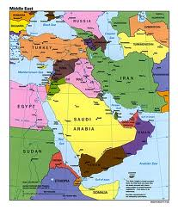
Regional Opportunities
Projects
US$1.68tn
Growth
4%
Sub Heading
Workforce
350m
Urbanisation
Middle Class
Spending
Saudi-23% GDP
Access
Africa
South America
Wealth
US$5 trillion to manage
India 7.2%
Notes:
The Middle East itself is full of opportunities today, many of which international business would like to access.
Opportunities for growth at 4%
Project expenditure at US$1.7trn
Estimated wealth at US$3.2trn.
But how can it access the opportunities safely?

Slide 6
Thanks but no thanks
Notes:
Answer is the shift in world trade.
Historically world trade centered between the East Coast of the United States and the UK, but with the emergence of Germany after the second world war trade flows started to shift East. As Japan increased its production the flow of trade further moved Eastwards, and this trend has gown and accelerated as we have seen the emerging markets of India, China and elsewhere in the East develop whilst the traditional markets of the West have struggled.
The spine of world trade is moving, and ever Eastwards so, unlike the atlas where the spine sits over London, today it sits right over the Middle East.
Vision, back in 1985 (when Wham was number one of the UK charts with Careless Whisper), was to capture that flow or trade and commerce as it washed over the region. To be prepared to be the gateway for that trade.
The challenge was that, when the Government reached out to 5000 businesses around the world, the overwhelming reason that they didn’t want to establish in Dubai was ‘legal and regulatory risk’. Boiled down, this was ‘legal and regulatory unfamiliarity’.
So to be able to ride on the crest of the wave of Global trade as it moves East, and to attract the people and businesses necessary to achieve that, Dubai created a centre which was familiar.
As it happens, it wasn’t just the Global opportunities that Dubai was positioning itself to capture, but the regional ones as well.

Slide 7
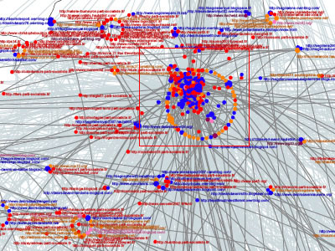
Traditional view of disputes in the Middle East
Notes:
Traditional view of business people about how complex litigation works. Complex, lengthy, not transparent

Slide 8
Go in a lamb

Slide 9
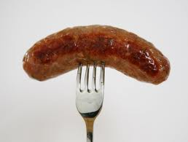
Come out a ……..

Slide 10
Creates….
Notes:
Highest ranked fear – not death or loneliness, but public speaking.
Fear and business mix like oil and water – they don’t
Would you drive a car if you didn’t trust the tyres? Maybe? How fast? Who with?
Fear, uncertainty or unfamiliarity of a market slows a market.
Nothing new – Dubai knew this in 1985

Slide 11
Heart of Commerce
Serve the international business community by maintaining a world-class judicial system which enjoys the confidence of the commercial sector

Slide 12
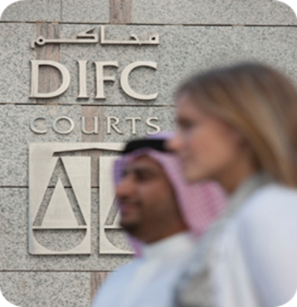
Who we are…
Up and running since 2008
Common Law
English language
Commercial and civil
World’s most advanced commercial court
Notes:
When it comes to resolving business disputes, it’s all about proving choice. Business likes to have a choice, whether litigations vs arbitration, or of the language of the dispute resolution forum (eg English)
Dubai has provided a choice of an English language common law court sitting alongside an Arabic language civil law court, both of which the parties to an agreement can choose depending on which suits them the most.

Slide 13
Who we are…
Open to the world
Taking away the risk
24/7 online all the time
Choice, Certainty and Confidence
Familiarity, Speed and Settlement
Notes:
When it comes to resolving business disputes, it’s all about proving choice. Business likes to have a choice, whether litigations vs arbitration, or of the language of the dispute resolution forum (eg English)
Dubai has provided a choice of an English language common law court sitting alongside an Arabic language civil law court, both of which the parties to an agreement can choose depending on which suits them the most.

Slide 14
Small Claims Tribunal - A private, cost-effective solution for SMEs
Claim amounts less than CAD185k
90% of cases settled within three weeks
No lawyers
Private and informal
Notes:
The SCT was established in October 2007 to deal with all claims under AED100,000 with further changes in limits of jurisdiction (AED200,000 for employments matters and up to AED 500,000 for all cases that parties have agreed in writing to use the SCT)
Parties cannot be represented by legal representatives at the SCT hearings.
Rules for SCT cases have been simplified to enable the claims to be resolved expeditiously-90% within 21 days
All hearings are in private
Especially effective for employment and debt claims. Give anecdote re sexual harassment.

Slide 15
Collaboration
Notes:
Appeals filed against judgments and awards made by the Court of First Instance;
Interpretation of any article of the DIFC’s laws based upon the request of the Courts in a claim that the Courts adjudicate or the request of any of the DIFC’s bodies or the request of any of the DIFC’s establishments provided that the establishment obtains leave of the Chief Justice in this regard. Such interpretation shall have the power of law.

Slide 16
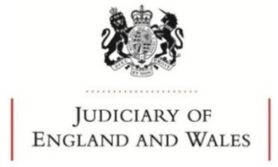
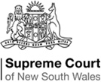
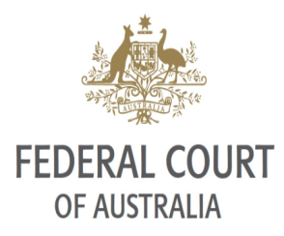
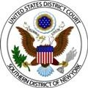
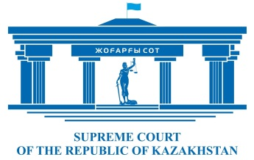
Other Courts
Memoranda of Understanding
Memoranda of Guidance

Slide 17
Notes:
Enforcement critical and we have protection of treaties covering the Arab world and the GCC, as well as reciprocal common law enforcement into other common law centres such as London.

Slide 18
DIFC Courts Order Enforcement
Notes:
Enforcement critical and we have protection of treaties covering the Arab world and the GCC, as well as reciprocal common law enforcement into other common law centres such as London.

Slide 19
What others are saying:
The Oath, Middle East Law Journal wrote: “The DIFC Courts are considered to be in the top three commercial courts in the world and are planning to expand their operations”
Reuters Article: “For many clients, mainly financial institutions and blue-chip corporations, DIFC Courts have become very important as a service centre…they’re one reason, if not the main reason, for being headquartered in the DIFC.”
James King, The Banker: “In recent years, Dubai has been developing its capabilities in the field of dispute resolution, with its crowning achievement being the creation of its Dubai International Financial Centre courts, which have only increased Dubai’s appeal as an international finance hub.”

Slide 20
A force for positive change?
The Honourable Mr Justice Cooke, Judge In Charge of the Commercial Court of England & Wales, remarked: “The Memorandum of Guidance between DIFC Courts and the UK Commercial Court sets out the basis upon which judgments of one court can be enforced in the other and helps to engender an atmosphere in which business can flourish."
Former UAE Minister of Justice HE Hadef Al Dhaheri commented: "The importance of Dubai offering two judicial systems, one Arabic language civil and one English language common law, should not be underestimated. The choice that is now offered to businesses operating here must be celebrated.”

